Slide 1
Lesson 2 - Gathering Data
Mack 2021

Slide 2
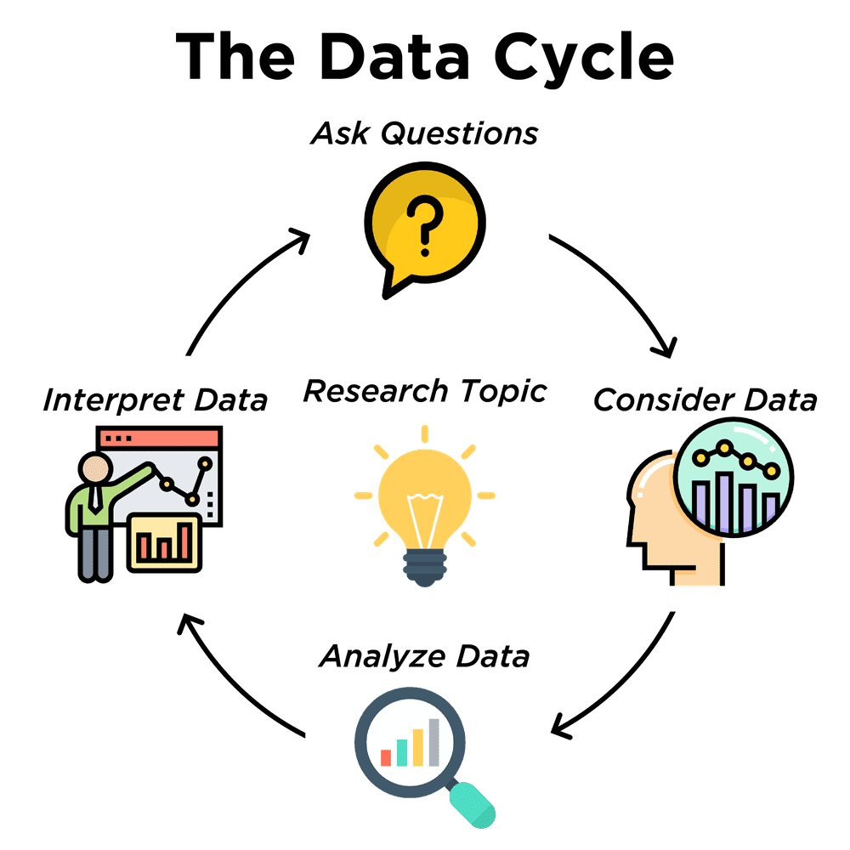
The Data Science Life Cycle
The data science life cycle is a sequence of steps for processing and using data.
Notes:
Data is, more often than not a living, breathing entity. It is always growing and changing. Because of this, the processes involved in data analytics and data science are ongoing and follow a cycle of steps and procedures. The Data Science Life Cycle is a sequence of steps for processing and using data.

Slide 3
The Data Science Life Cycle
Ask Questions - formulate statistical questions that can be answered with data
Notes:
The first step of the data cycle is to ask questions. These questions are the statistical questions that we learned earlier.

Slide 4
The Data Science Life Cycle
Ask Questions - formulate statistical questions that can be answered with data
Consider Data - collect and record data, or find an existing dataset
Notes:
The next step would be to consider data. We can gather and collect data by using surveys and recording it ourselves, or by finding an already existing dataset.

Slide 5
The Data Science Life Cycle
Ask Questions - formulate statistical questions that can be answered with data
Consider Data - collect and record data, or find an existing dataset
Analyze Data - perform statistical analysis, run calculations and/or create data displays to identify patterns and relationships
Notes:
Once we gather the data, the next step would be to analyze it. During this step, we could perform a statistical analysis or create data displays such as a graph or chart so that we can identify patterns or relationships.

Slide 6
The Data Science Life Cycle
Ask Questions - formulate statistical questions that can be answered with data
Consider Data - collect and record data, or find an existing dataset
Analyze Data - perform statistical analysis, run calculations and/or create data displays to identify patterns and relationships
Interpret Data - answer questions and summarize the results.
Notes:
Lastly, we use everything that we’ve learned and that the data has revealed to us to answer the question, if possible, and summarize the results.
Usually, the results lead to more questions and the data cycle begins again.

Slide 7
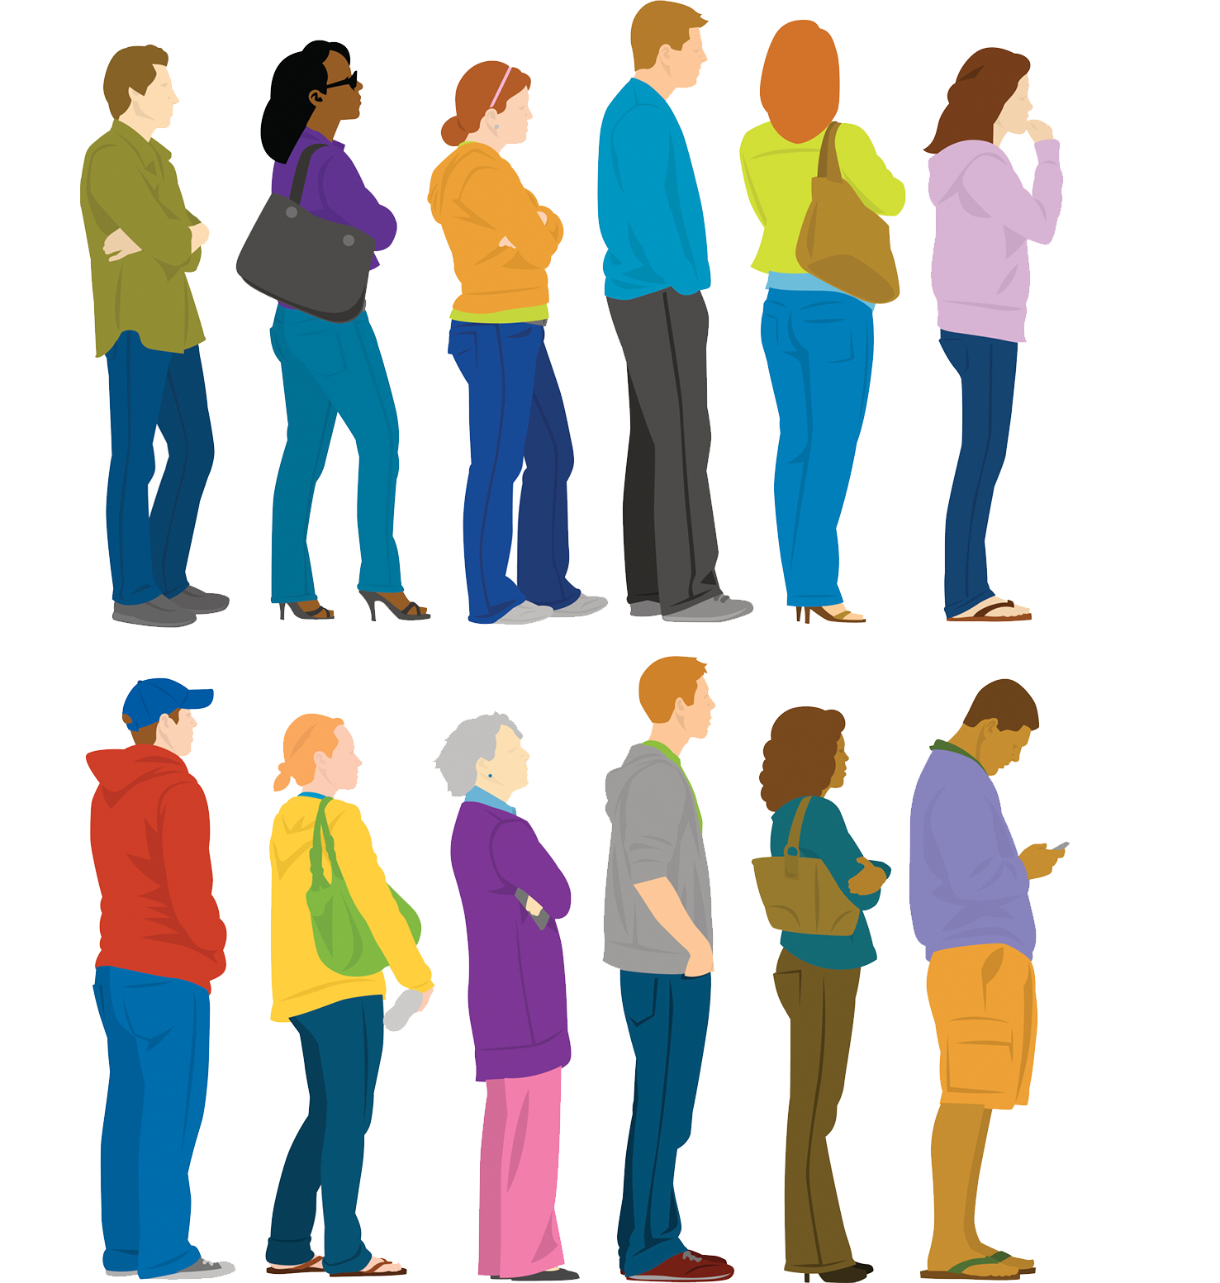
Consider Data
age
height
shirt_color
footwear
has_bag
Notes:
So, let’s start considering some data. Take a look at this group of people waiting in two lines. What kind of data could be collected regarding this group? Pause the video and think of a few different categories in which data could be collected for this group of people. Some of the categories that you may have come up with could be the color of their shirts or pants, or their hair color, whether or not they are wearing shoes or sandals, are they holding a bag or not? If you were able to talk to this group of people, you could find out their age or measure their height.
Categories used in data science should be described with a short but descriptive variable name. Something like age, height, shirt_color, and so forth. You might have noticed that these variable names are all lowercase and include an underscore if there is more than one word. This will help later on when we use programming to structure the data.

Slide 8
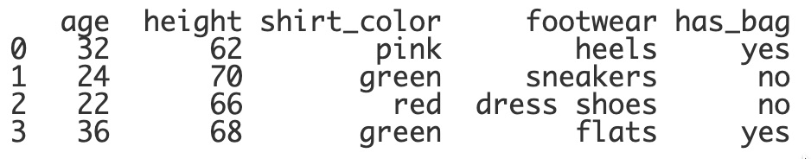
Structuring Data
Data Table
Notes:
We can structure data by placing the information into a data table. The data table is the entire table of data.

Slide 9
Structuring Data
Rows
Notes:
Data tables consist of rows, which are horizontal ...

Slide 10
Structuring Data
Columns
Notes:
… and columns that are vertical. We’ll take a look at how programming can help us create a data table in a the next video in this lesson.

Slide 11
Consider Data
Notes:
Now that the data is structured, we can continue to explore and consider this data. Take a look at the values in the footwear column. How do these differ from the values in the height column? The height column consists of numbers. These would be pretty easy to put in order or use to find the average height, or the tallest or shortest. The values in the footwear column are definitely different. These are more categorical. It’s not as clear how you would consider and use this data.

Slide 12

Quantitative and Qualitative
Quantitative data is numerical data that can be counted or measured.
How many cups of coffee did you drink today?
Qualitative data can be divided into different categories.
What is your favorite type of coffee?
Notes:
The different types of data that can be collected are quantitative and qualitative values. Quantitative data is numerical, like the values in the height column. Qualitative data is categorical, like the values in the show_type column. Both types of data are very useful.

Slide 13
Quantitative Data
How many hours of sleep do teens get?
What’s the average price of a mobile phone?
Who is the youngest teacher (age) in the school?
Notes:
Questions that require knowing a specific amount of something require quantitative data. A question like “How many hours of sleep do teens get?” would need quantitative data to be able to answer it. When you use quantitative data, you can perform arithmetic computations like finding the average price of a phone or the youngest teacher in the school.

Slide 14
Qualitative Data
What method of transportation do you take to get to school in the mornings?
What is your reason for unsubscribing from this mailing list?
Which is the most popular color for cars?
Notes:
Qualitative data is useful to answer questions that deal with the “why”, the “how” , or the “which one.”

Slide 15
Qualitative Data
Which students’ cell phones have an area code of 631?
Notes:
It’s important to be careful to not automatically think that seeing numbers means that the data is quantitative. A good rule of thumb is to think about whether or not you are able to perform arithmetic computations or not. For example, you can’t find the average zip code or the smallest color.

Slide 16
Lesson Vocabulary
Term | Definition
data science life cycle | A sequence of steps for processing and using data.
quantitative data | Numerical data that can be counted or measured.
qualitative data | Data that can be divided into different categories.

Slide 17
Which of the following represents a variable that would produce quantitative data?
Notes:
🍐 This is a Pear Deck Multiple Choice Slide. Your current options are: A: texture, B: flavor, C: speed, D: hair_color,
🍐 To edit the type of question or choices, go back to the "Ask Students a Question" in the Pear Deck sidebar.

Slide 18
Which question can be answered using qualitative data?
Notes:
🍐 This is a Pear Deck Multiple Choice Slide. Your current options are: A: How many siblings does each student have?, B: Which students live in Augusta?, C: Who has the most cats?, D: Who lives the closest to school?,
🍐 To edit the type of question or choices, go back to the "Ask Students a Question" in the Pear Deck sidebar.

Slide 19
Researchers often turn qualitative data into quantitative data so that they can more easily analyze it. Which of the scenarios below is an example of this?
Notes:
🍐 This is a Pear Deck Multiple Choice Slide. Your current options are: A: In which month were the most students born?, B: Who scored the highest on the last math test?, C: On a scale of 1-10, how much did you enjoy the movie?,
🍐 To edit the type of question or choices, go back to the "Ask Students a Question" in the Pear Deck sidebar.

